Slide 1
RECURSION
Consider what happens within the computer when subprograms are called:
The system ( or program) must remember
- the place where the call was made (so that it can return there after the subprogram is complete).
- it must also remember all the local variables, processor registers, etc. (so that information will not be lost while the subprogram is working).
=> Procedure Activation Record associated with each subprogram.
3 subprograms, A, B, + C
  A invokes B
  B invokes C
Starting sequence A, B, C ……
Finishing sequence C, B, A ….
=> Last In, First Out => LIFO => Stack
Notes:
We can think of all this information as one large record – a temporary storage area for each subprogram.
- called a Procedure Activation Record
‘A’ starts work first but finishes last, sometime after B finishes, which in turn cannot finish until C finishes
- LIFO
- Hence a stack plays a key role in invoking subprograms in a computer system.

Slide 2
Procedure Activation Records (Stack Frames) are stored using a stack data structure.
These Procedure Activation Records can come from different subprograms or from repeated occurrences of the same program.
Recursion is the name given to the case when a subprogram invokes itself or invokes a series of other subprograms that eventually invokes the first subprogram again.
Linear Recursion : When a subprogram invokes itself once.
Binary Recursion : When a subprogram invokes itself twice.
Non-linear Recursion : When a subprogram calls itself many times (LOOP).
Mutual Recursion : When a subprogram invokes a different subprogram that invokes the first subprogram again.
  e.g. A invokes B, B invokes A

Slide 3
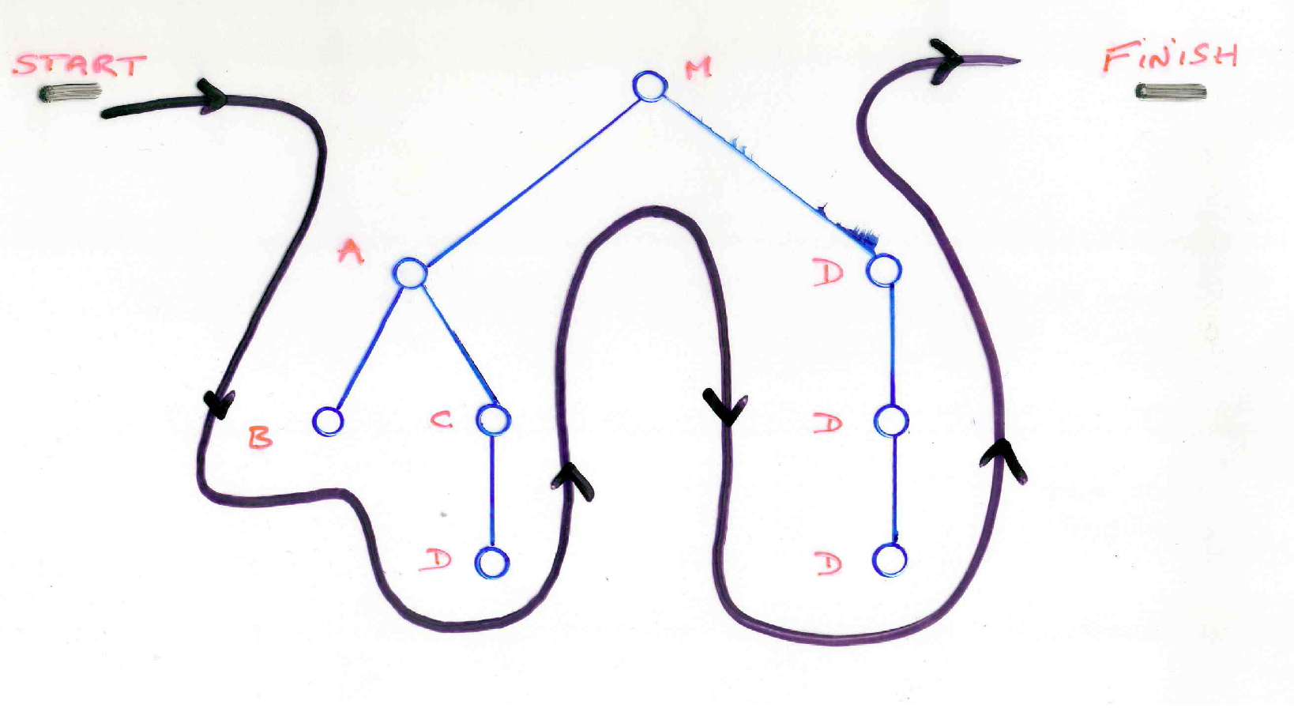
Tree Of Subprogram Calls
shows the order in which subprograms are invoked
Stack Frames For Subprogram Calls

Slide 4
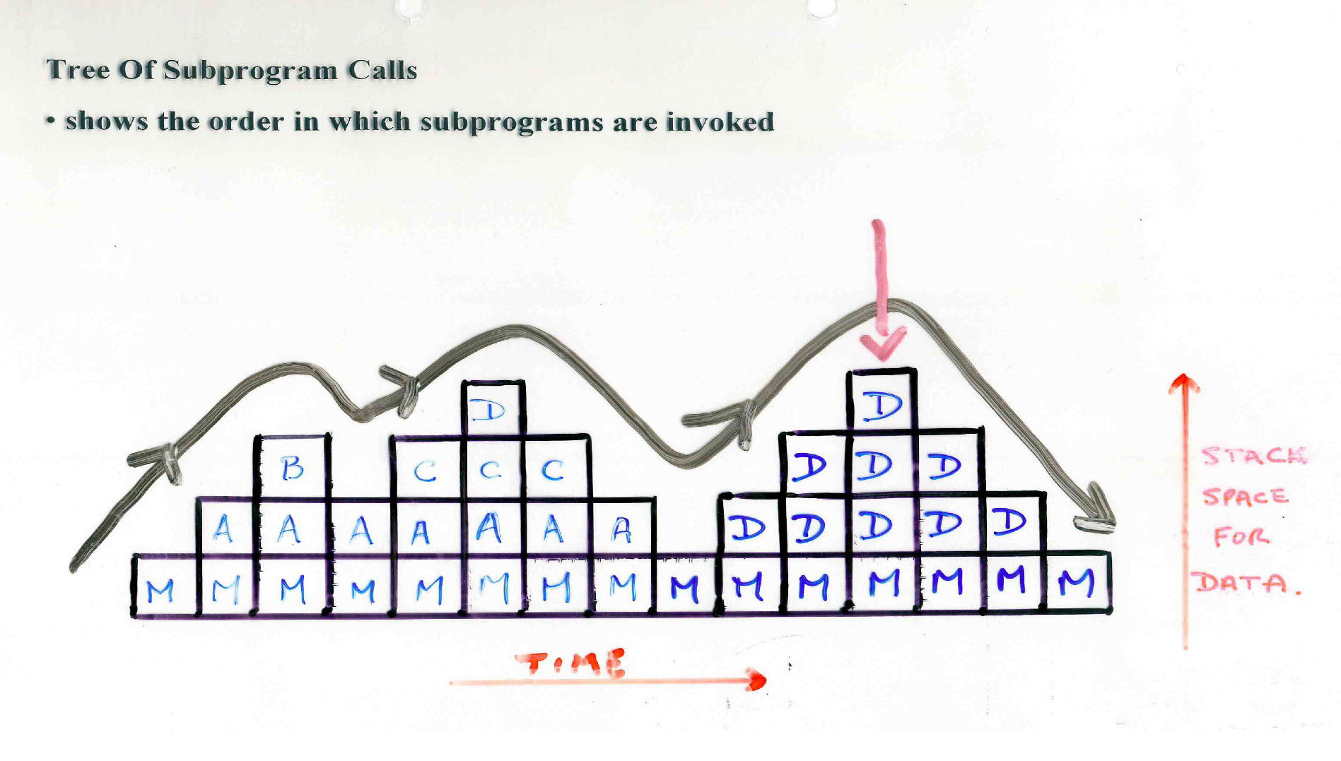
Tree Of Subprogram Calls
Notes:
A flatter tree will not need as much stack space but may have more calls to functions than a very deep stack

Slide 5
Problem Reduction: (Essence of Reduction)
To obtain the answer to a large problem, a general method is used that reduces the large problem to one or more problems of a similar nature, but a smaller size.
The same general method is used for these subproblems, and so recursion continues until the size of the subproblems is reduced to some smallest base case, where the solution is given directly without using further recursion.
Every recursive process consists of 2 parts:
A smallest, base case that is processed without recursion; and
A general method that reduces a particular case to one or more of the smaller cases, thereby making progress toward eventually reducing the problem all the way to the base case.

Slide 6
A more detailed explanation of RECURSION
A recursive method is called to solve a problem.
The method actually knows how to solve only the simplest case (or so called BASE CASE).
If the method is called with a base case, it will return a result.
If the method is called with a more complex problem, the method divides the problem into two conceptual pieces -
        a piece that the method knows how to do (a base case)
        a piece that the methods does not know how to do.

Slide 7
A more detailed explanation of RECURSION
To make recursion feasible, the latter piece must resemble the original problem, but be a slightly simpler or slightly smaller version of the original problem.
Because this new problem looks like the original problem, the method invokes (calls) a fresh copy of itself to go to work on the smaller problem. We call this a RECURSIVE CALL OR the RECURSION STEP.
The recursion step also normally includes the keyword RETURN because its result will be combined with the portion of the problem the method knew how to solve, to form a result that will be passed back to the original caller.

Slide 8
A more detailed explanation of RECURSION
The recursion step executes while the original call to the method is still open (i.e. the original has not stopped executing).
The recursion step can result in many more recursive calls, as the method divides each new subproblem into 2 conceptual pieces.
For the recursion to terminate -
  each time the method calls itself with a slightly simpler version of the original problem, the sequence of smaller and smaller problems must eventually converge on the base case.
  At that point, the method recognises the base case, returns a result to the previous copy of the method and a sequence of returns ensues up the line until the original method call eventually returns the final result to the caller.
This procedure sounds exotic compared to the conventional problem solving you have performed to date.
Let’s now look at actual problems that can be solved recursively….

Slide 9
GENERAL FRAMEWORKS
A. Linear Recursion
………….linear(……)
{
if “TERMINATION CONDITION SATISFIED”
(a) Return Some Value(s);
else {
(a) Perform some action(s);
(b) Make a further recursive call to ‘linear’
}
}

Slide 10
Factorial uses linear recursion.
NOTE: Linear recursion can be much more expensive in its use of memory than simple iterative solutions, which tends also to make them slower.
Iterative Factorial:
long Factorial (long n)
{
int fact;
fact = 1;
while (n > 0)
{
fact = fact * n;
n = n – 1;
}
return fact;
}

Slide 11
B. Binary Recursion (2 smaller problems)
………..Binary (….)
{
if termination condition met
(a) perform some action(s) and/or
return some value(s)
else {
(a) perform some action(s)
(b) make a recursive call to ‘Binary’ that solves one of the 2 smaller problems.
(c) make another recursive call to ‘Binary’ to solve the other smaller problem.
}
}
Notes:
Binary recursion : it is easier to search thru 2 groups of 50 numbers than 1 group of 100 numbers

Slide 12
Non-Linear Recursion
……non-linear(….)
{
for (k=j; k<n; k++)
{
(a) perform some action(s)
(b) if termination condition is NOT met
(b.1) make a further recursive call to ‘non-linear’
else
perform some action(s) and / or return some value(s)
}
}

Slide 13
Mutual Recursion
……mutual(…)
{
………..
.……….
internal call to ‘another’;
………..
………..
}
……another(…)
{
………..
.……….
internal call to ‘mutual’;
………..
………..
}

